Slide 1
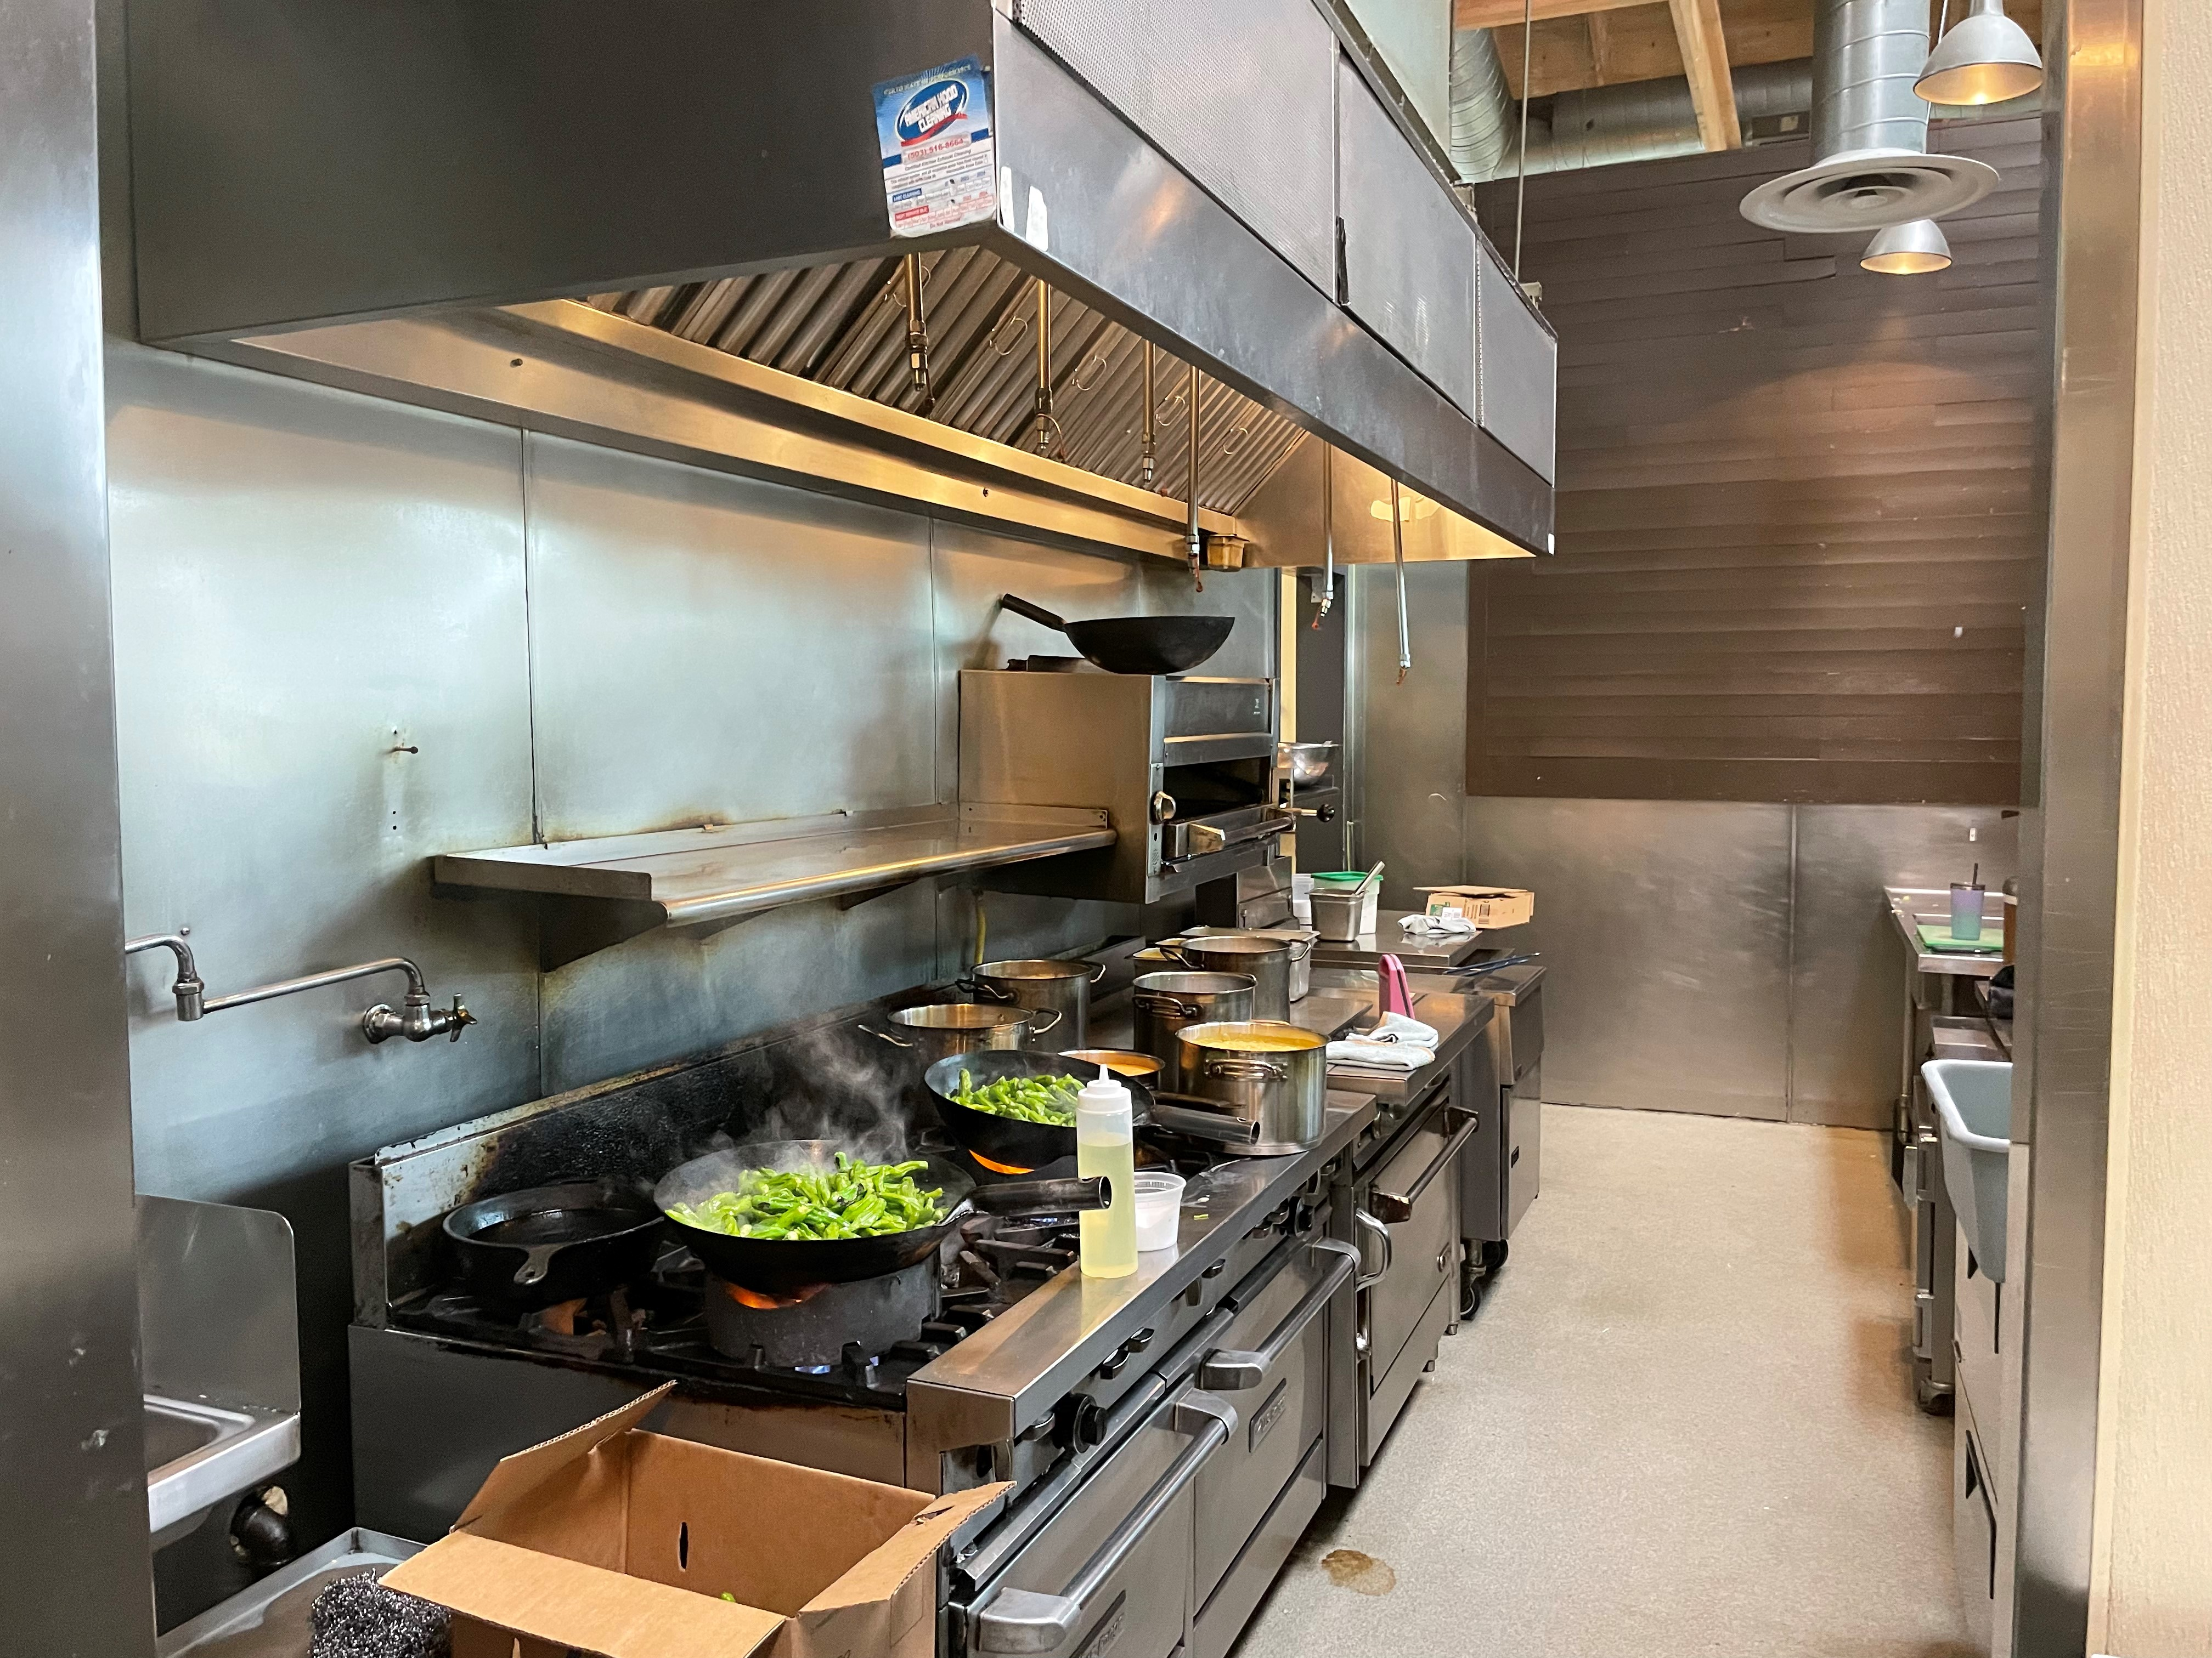
PM2.5 Exposure of a Line Cook
by
Zachary Golden

Slide 2
Introduction
Customers have complained about the air being “spicy”
Working under the ventilation system, you still breathe in fumes
Wherever you are in kitchen, certain dishes will make you sneeze
After mask mandate was lifted, irritation was noticeably worse

Slide 3


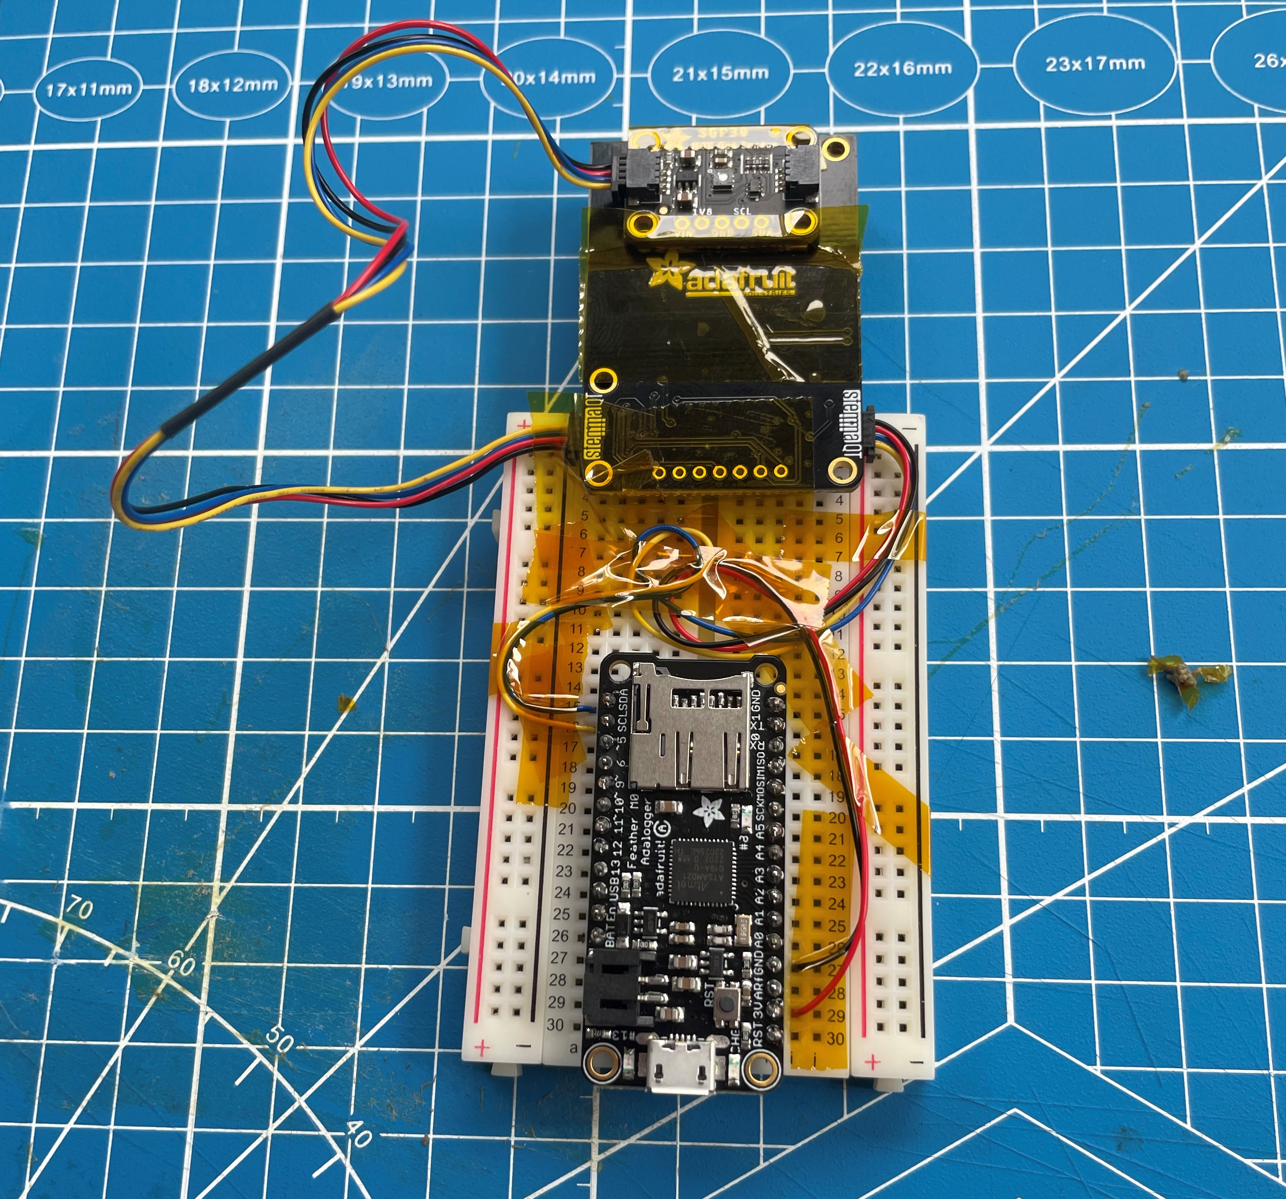
Methods
Plantower PM2.5 Sensor
SGP30 eCO2 and TVOC Sensor
Adafruit Feather Adalogger
Collected data night before as a control
Sampled data every five minutes for a whole day on a double shift

Slide 4
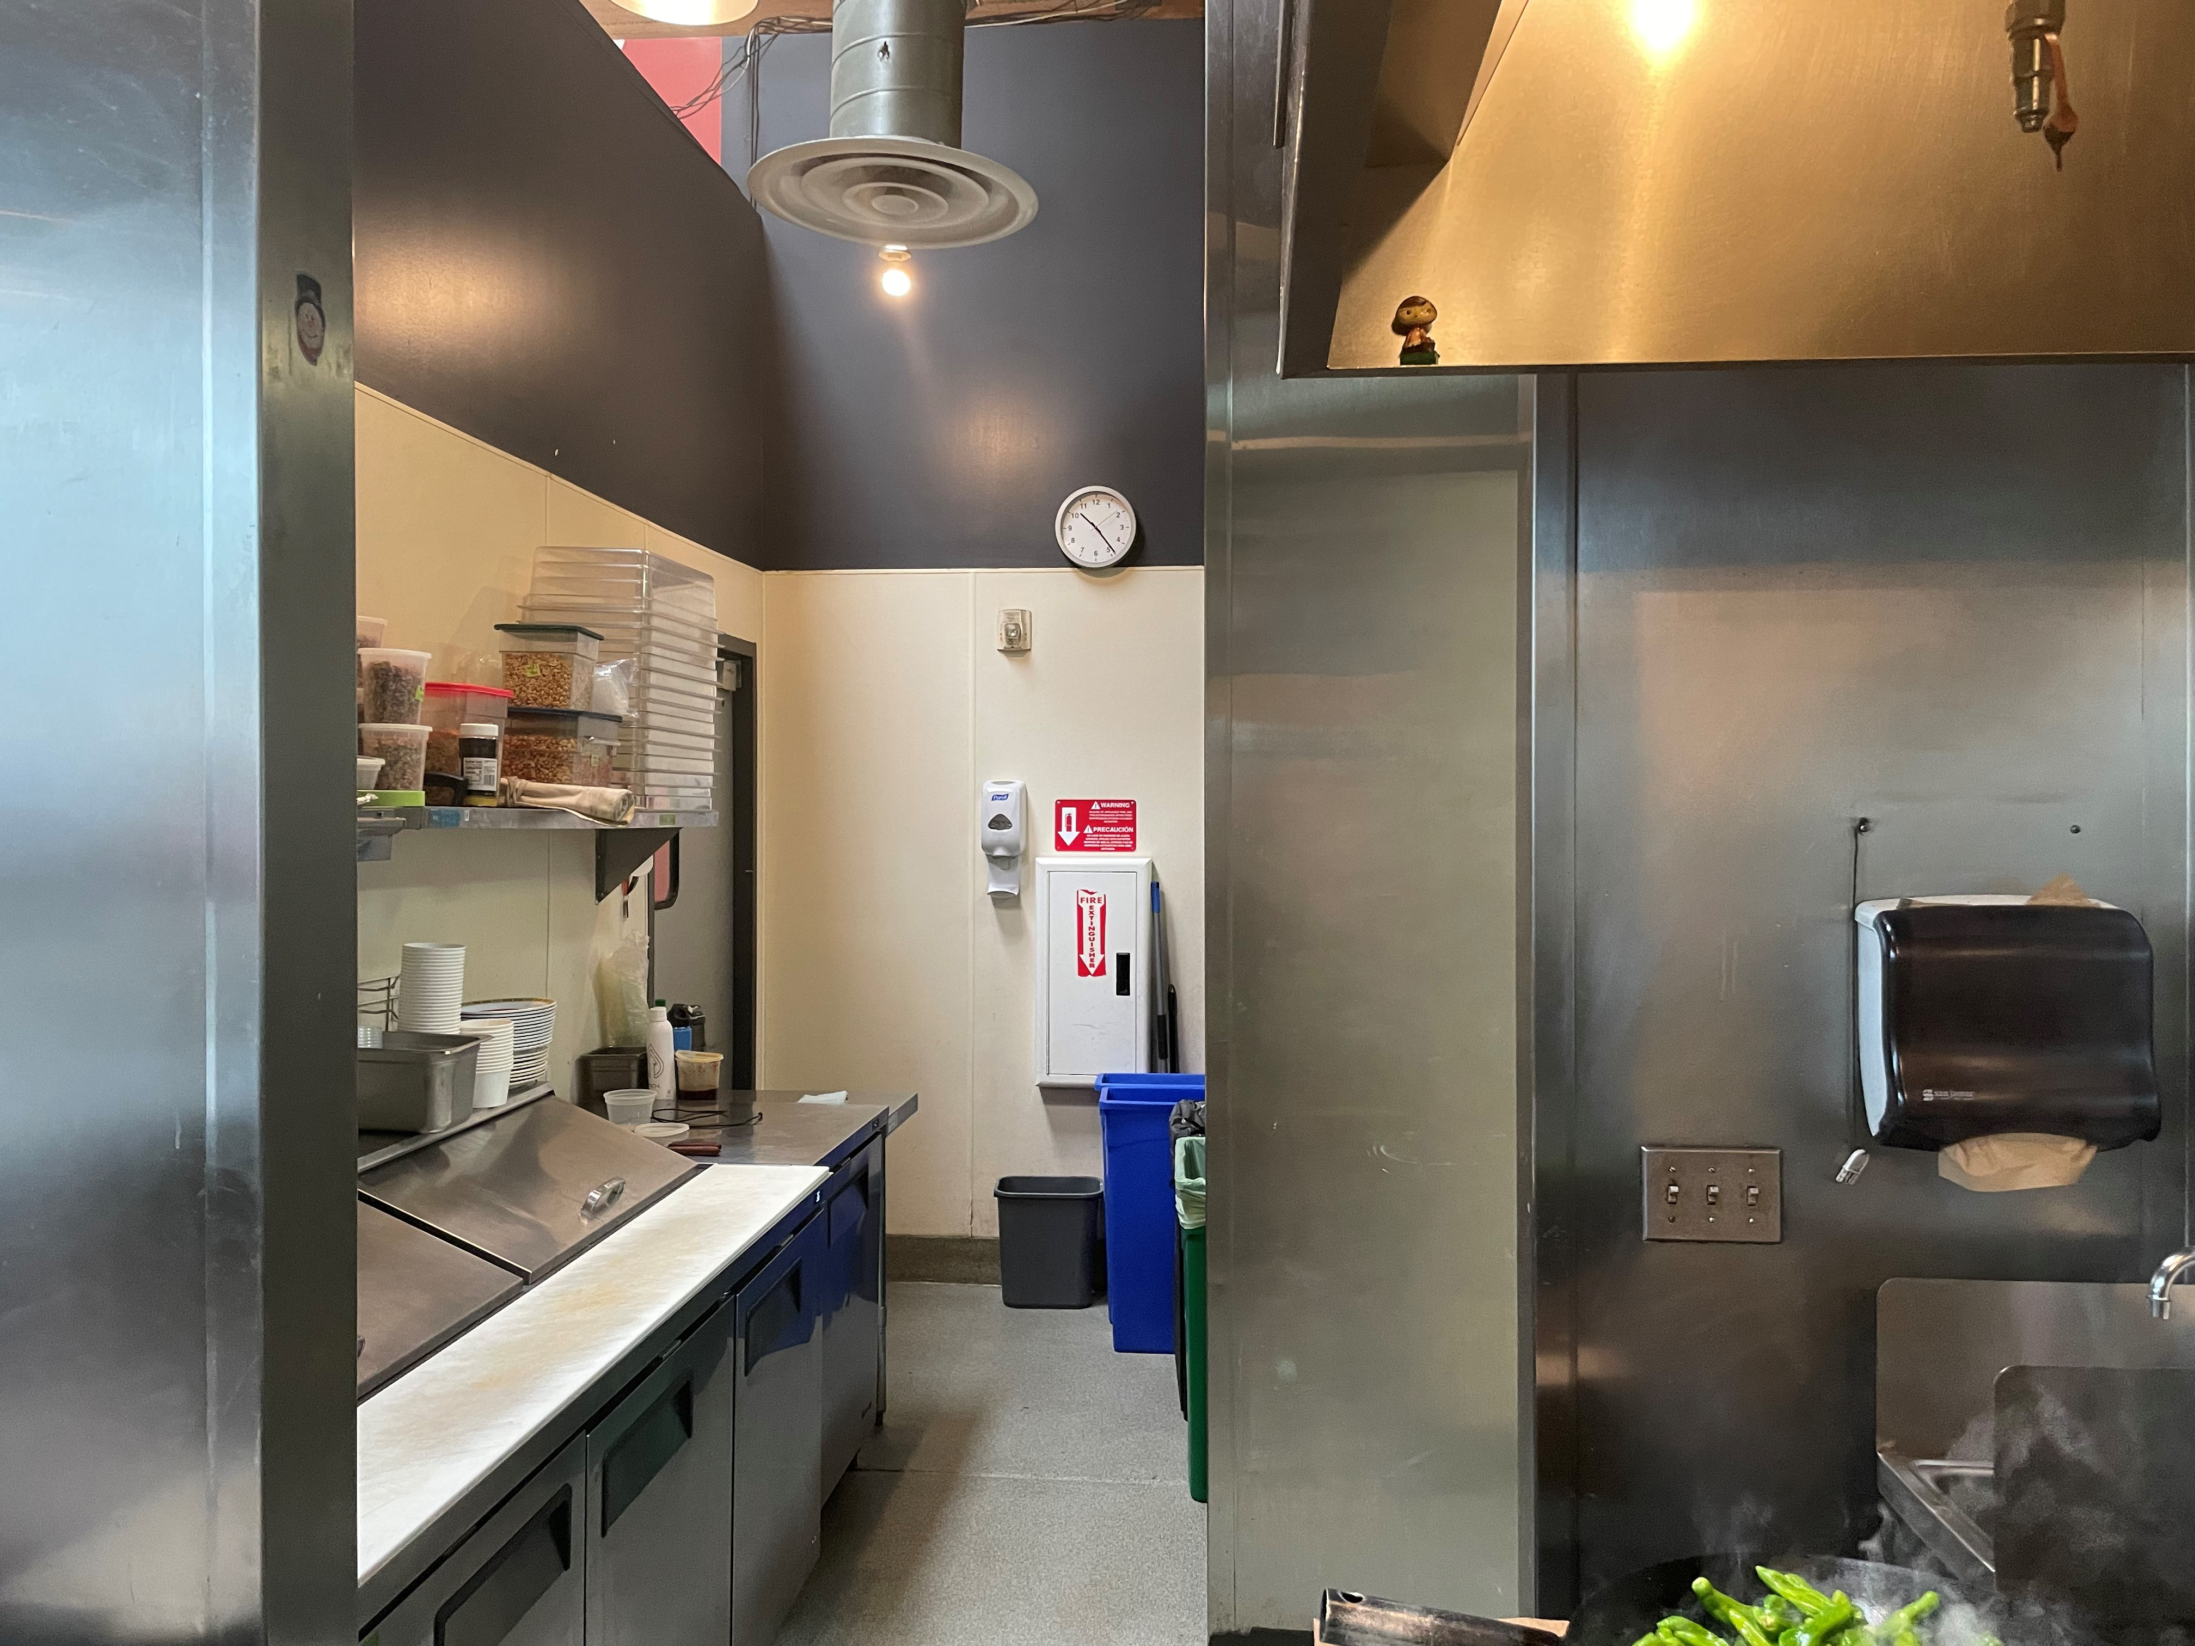

Slide 5
Results

Slide 6
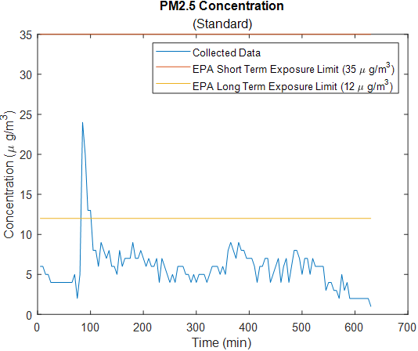
Results

Slide 7
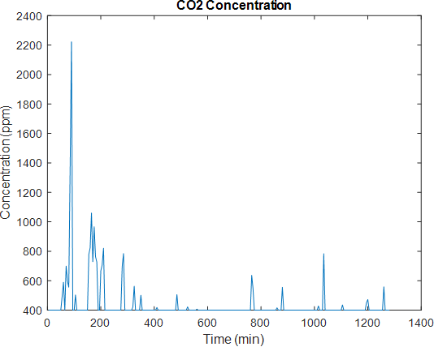
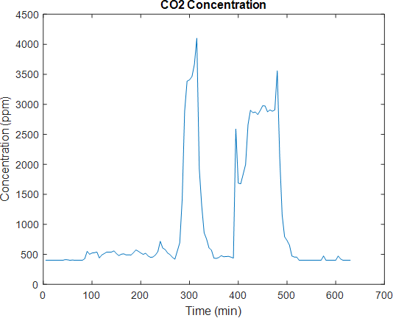
Results
Notes:
Our neighbor was talking about the movie legend with tom cruise and directed by ridley scott

Slide 8
Results

Slide 9
Conclusion
Line cooks are exposed to dangerous levels of PM2.5 while under a hood vent
Line cooks are exposed to dangerous levels of PM2.5 when not under a hood vent
Line cooks should wear PPE

